Slide 1




Staff and Sussex Patients Views on Access to GP-led Services
Published August 2022

Slide 2
Content
This is a collaborative project between Healthwatch in the South of England and the NHS
Introduction
Collaborating to get good outcomes for all
Timeline - How GP-led Services have been asked to operate at different stages of the Pandemic
What frontline staff in GP surgeries shared
Snapshot of themes from patients
What patients shared in more detail
NHS England priorities for 2022-23
Improving local access shared by Commissioners
Recommendations and Next steps

Slide 3

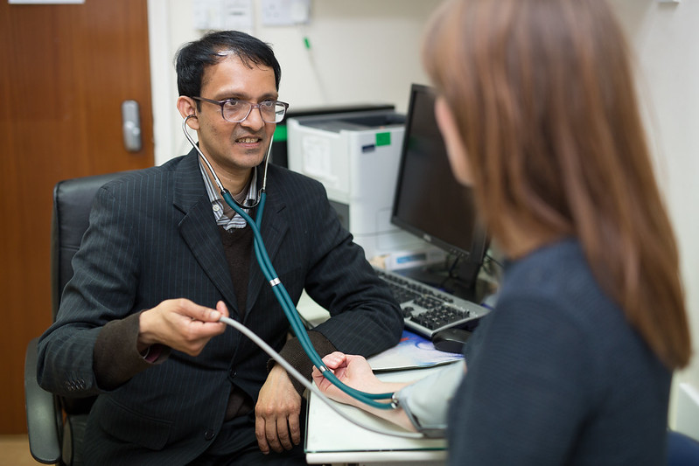
Introduction

Slide 4

Introduction
Timely access to locally available clinical support when peoples’ health needs have gone beyond the scope of self-care and community pharmacy is an essential part of maintaining individual wellbeing.
It is a key factor in levelling up and addressing the health disparities within our society. Access to GP-led services also impacts the capacity of, and need for, hospital-based care (such as A&E).
The COVID-19 pandemic has put a huge strain on the NHS and impacted how the public access health services.
Like many organisations, general practice needed to adapt quickly as the UK went into lockdown and respond to new ways of working such as offering video and telephone consultations. Some people have told us that these new ways of accessing GP services have worked well, allowing them to save time and get the help they need, quickly. But for others it’s been more difficult, time consuming and frustrating to access support when they need it.
In addition to providing day to day care, staff at GP practices have been working hard to deliver the vaccine programme and catch up on the backlog of treatments. General Practice has needed to follow NHS England operating standards, revised at different points of the pandemic (see Timeline p10).
The NHS provides care and treatment to people not commodities and as such our access to services may not be as prompt as we experience in other areas of life.

Slide 5
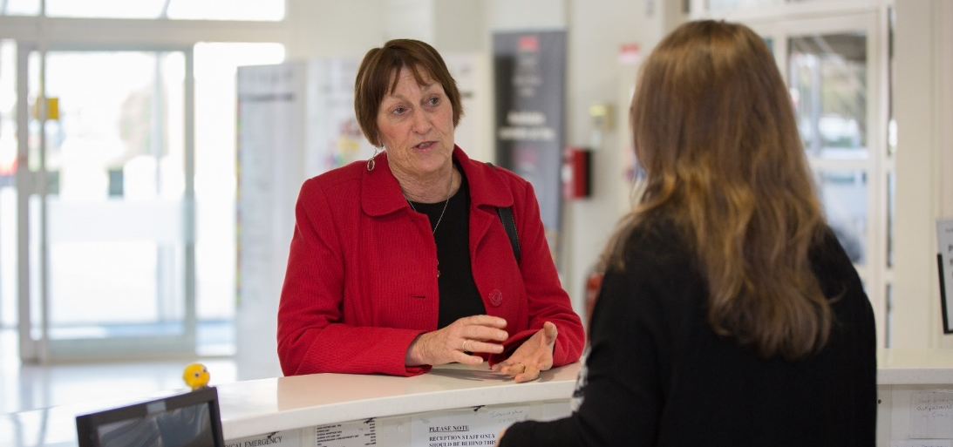
The media has recently been fuelling reports that GP practices have been closed during the pandemic, despite the fact that in Dec 21, 29.1 million consultations were available, of which 3.9 million were COVID-19 vaccinations. Nationally, this is 1 million and 40,000 more than the 24.16 million consultations available in Dec 2019. The additional funding provided by central Government is enabling practices to make changes as shown on page 34.
Similarly, there is a lot of media and national attention on the backlog of operations for hospitals and the need to reduce waiting lists, but we rarely see any mention of the impact this has on GP led services who are the first port of call for those people who are waiting for a procedure or operation.
Local Healthwatch have been listening to people’s experiences of accessing GP led services and we have also been listening to the staff who have been working in GP practices through the pandemic.
When trying to improve and build better systems for patients and staff It is essential to listen to peoples’ voices and collaborate with those who use services and also those that provide them.

Slide 6
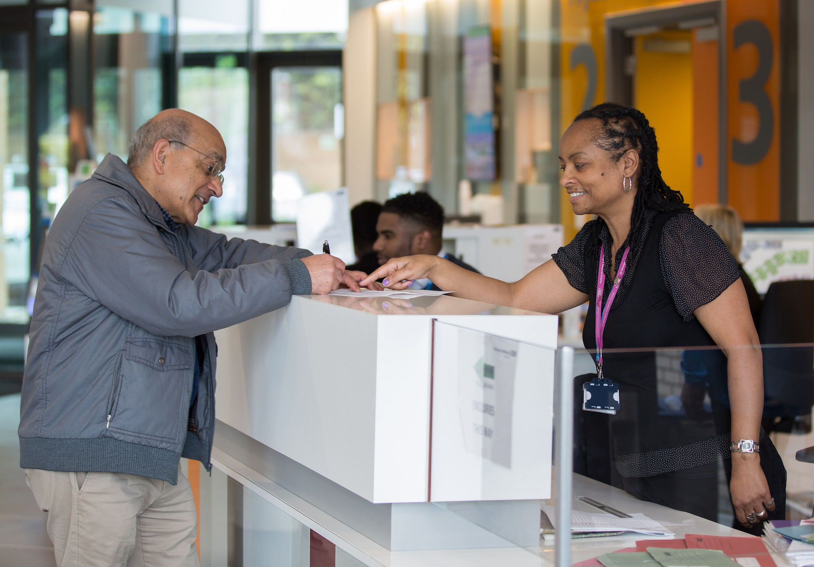
Collaborating to get good outcomes for all

Slide 7
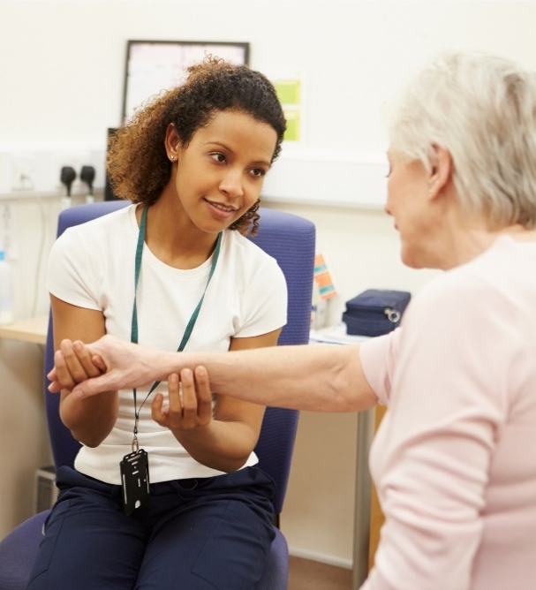
Collaborating to get good outcomes for all
Local Healthwatch will always remain independent and impartial while working with partners to get thing done.
This project emerged because local Healthwatch was receiving a high level of feedback from the public regarding primary care. Healthwatch managers met to discuss this emerging trend and decided that it was a sensitive issue that required a measured and balanced response.
We agreed that involving and understanding the way practices had been asked to respond and change during the pandemic was critical to establishing a conversation between practices and the people they support.
Early discussions with the NHS and other stakeholder showed that the best way to ensure success would be to establish a regional advisory/working group that would be made up of key stakeholders in primary care and beyond. This included: CQC, GP’s, Practice Managers, Reception staff, Local Authority Scrutiny Officer, Commissioners, Integrated Care System communication staff and Healthwatch. A local advisory group was also set up on the Isle of Wight to gather the views of practice managers and members of GP Patient Participation Groups.

Slide 8

The level of partnership and collaboration, on this scale, was a new approach for us but one that was necessary to deliver on this important agenda.
The advisory group has supported the work and been instrumental in developing the staff and public surveys, communications, challenge and solution finding. Going forwards the advisory group will be key in defining and contributing to the next steps and ensuring that we identify constructive solutions to benefit both GP staff and also the people who use their services.
This way of working has been extremely successful, and has offered up considerable learning.
We are very proud of the fantastic work undertaken to date by the advisory group, the local Healthwatch teams and the collaborative work across the south of England.
The fact that we have had over 250 responses for the primary care staff survey, and over 7000 responses to the public survey (of which 1,500+ came from Sussex residents), is testament to that.
We have developed trusting and collaborative relationships with primary care and the broader system partners that we can build on going forwards – this is a great achievement.

Slide 9

Timeline of changes

Slide 10
Timeline of changes
How GP-led services were asked to operate at different stages of the pandemic
A GP Timeline of the COVID-19 Pandemic
March 2020 | GPs are informed by NHS England that remote consultations are to be rolled out to the general public, with face to face consultations only available if absolutely necessary. Total triage was introduced (every patient contacting the practice is first triaged before booking a consultation. This was seen as important, for reducing avoidable footfall in practices, to protect patients and staff from the risk of infection.)
December 2020 | First Covid-19 vaccine is administered in the UK.
May 2021 | New Guidelines are given by NHS England reversing the need to ‘total triage’ and that ‘all practice receptions should be open to patients’ to minimise digital exclusions.
September 2021 | Downing Street stated ‘the public rightly may choose to want to see their GP face to face – and GP practices should be making that facility available to their patients’.
December 21 | GP practices were asked by the Government to prioritise covid vaccination/boosters and urgent consultations.

Slide 11
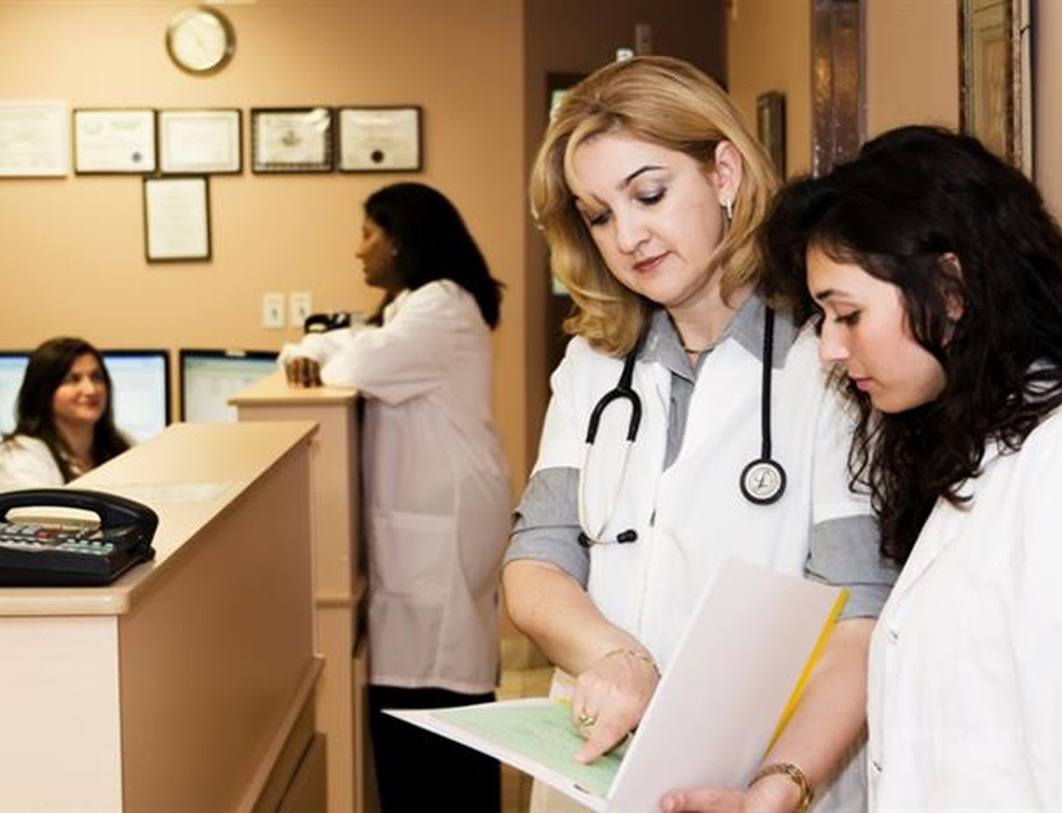
What frontline staff shared

Slide 12
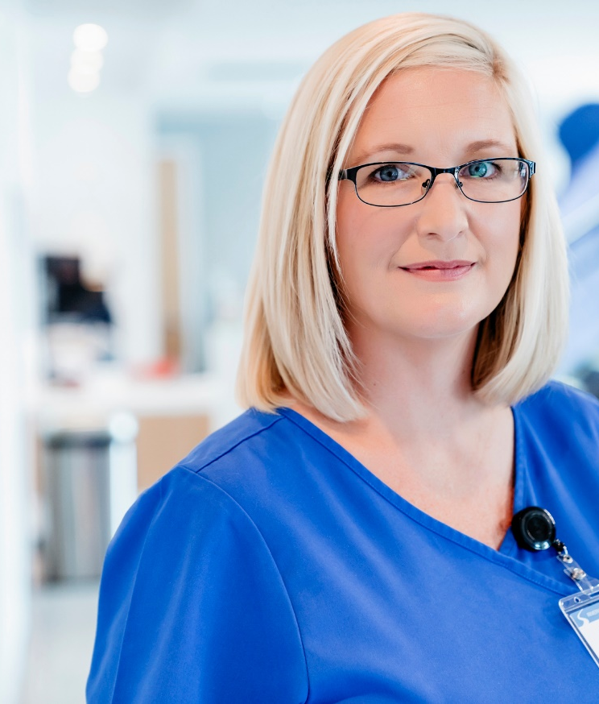
What frontline staff in GP surgeries shared
In November 2021, Healthwatch opened a survey for all staff in GP surgeries to get their views on how their work has changed in the last 18 months. They were asked to share their thoughts on their surgery - the strengths and where there could be improvements.
267 people responded from a variety of job roles – 55% were non-clinical.
The emerging themes from this survey include a tired, overstretched workforce that are becoming frustrated with the public’s demands and attitudes.
There is a call for patient engagement to highlight the way in which triaging works and why this is necessary.
However, what is most striking is the pride the staff have with how they have delivered services and consultations to the public and the way in which they have adapted their working practices in the fast paced changes that the COVID-19 pandemic brought about.

Slide 13
“I am very proud of the service the medical centre in which I work delivers to its patients but the continued increased pressure cannot be sustained and staff morale is at rock bottom, particularly as patients don’t seem to appreciate how swift a service we provide.”
(Non-clinical staff, 4+ years in service)

Slide 14
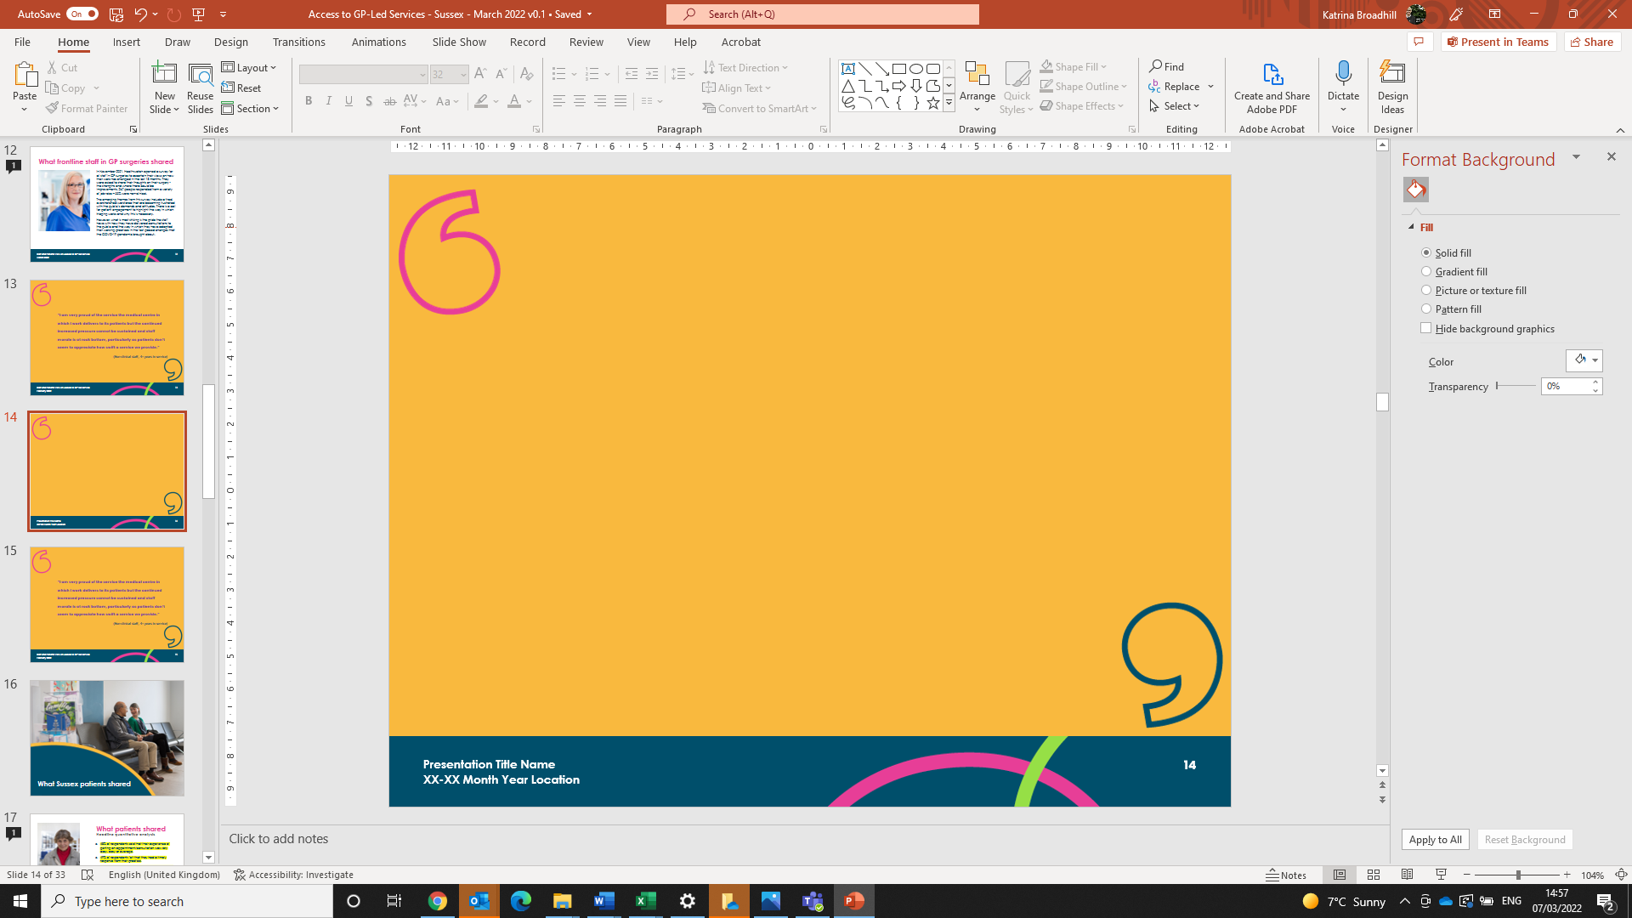

Comments from GP staff
General practice has massively changed in the past 18 months. It has been very stressful. We are very tired and also feel under attack from the mass media who appear to have an agenda against us.
We are particularly proud of our Covid vaccination program which still continues. Our team have played a major part in this continuing into the booster/flu stage. It has been difficult but rewarding to have vaccinated so many patients.
Ceasing battering of GP practices would be most welcome. We saw 75% of our patients via face to face appointments in August and our cancer referrals have not fallen during the pandemic - might be nice if DOH [Department of Health and Social Care] and press recognised achievements rather than constant denigration of primary care in the media.
The media needs to be brought to task over their horrific condemnation of GPs - and sometimes we wish we could bring our patients in for a "day in the life of".... to see what actually goes on behind the scenes - the public think a GP surgery is run by a couple of Receptionists, a Practice Manager, a Nurse and maybe a few GPs - if they knew we had teams of staff of over 50 people etc they might begin to see the bigger picture.
Morale is generally good, but staff are tired. We look forward to getting back to some form of normality and hopefully returning to as things were prior to the pandemic.

Slide 15
What 3 things do patients need to know?
112 staff responded to this question: What three things do you think patients need to know before they contact your practice, that would help them and you? These are the top messages in order of frequency/popularity:
The GP practice is under huge pressure and may be short of staff due to Covid – please be patient, we are committed to helping you (40 mentions).
Options to try before contacting the practice, e.g. pharmacy, self help, NHS 111, online info, physio and other First Contact Practitioners, etc (30 mentions).
You may be referred to a practitioner other than a GP – most appointments will be via phone first followed by face to face consultation if needed (19 mentions).
Be prepared: give a clear description of symptoms and when they started (15 mentions).
How triage works, i.e. the receptionist will ask you questions to direct you to the practitioner best suited to your needs (12 mentions).
How to book an appointment (online or phone) and expected length of appointment (12 mentions).
Don’t be rude to staff, it won’t help (9 mentions).
Face to face appointments are an ongoing option (8 mentions).
Less frequently mentioned but still common were:
Follow our Covid requirements (mask, waiting arrangements, etc).
Book on the day appointments over the phone – book advance appointments online.

Slide 16

Snapshot of themes from patient feedback

Slide 17
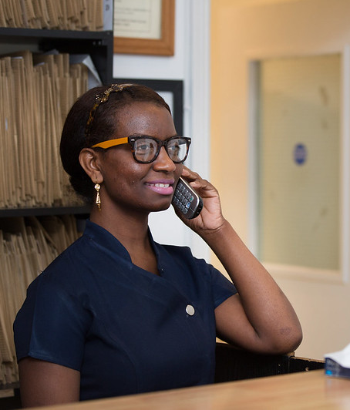
Snapshot of themes
Long Telephone Queues – Large amount of feedback across all areas regarding the length of time it takes to get through to surgeries. Many commented that they had to try multiple times. The feeling of frustration can often be exacerbated by lengthy messages whilst on hold.
Availability of consultations – For those registered to surgeries that appear all to offer on the day consultations, they have commented that by the time they get through on the phone, all the allocation for the day had gone. This is despite calling as soon as the lines open. They are told to try again the next day.
Telephone consultations – Mixed feedback with some preferring the immediacy and efficiency of telephone consultations, whilst others question the diagnostic effectiveness of them. Most respondents would prefer a more narrow time window for a call back in order to fit in with working and home pressures.
Online Services – A mixed collection of responses from those who like the convenience of online services such as eConsult, to those who find it frustrating or impersonal. Digital exclusion is a factor for those who don’t use the internet or who cannot get the system to work for them.
It should be noted that sources of evidence suggests online booking is not always favourable, nor universally available.
“Getting through is not so much the problem. Its listening to the recorded message on and one, that annoys me. I forget which number to press as there is so much to listen too.”

Slide 18
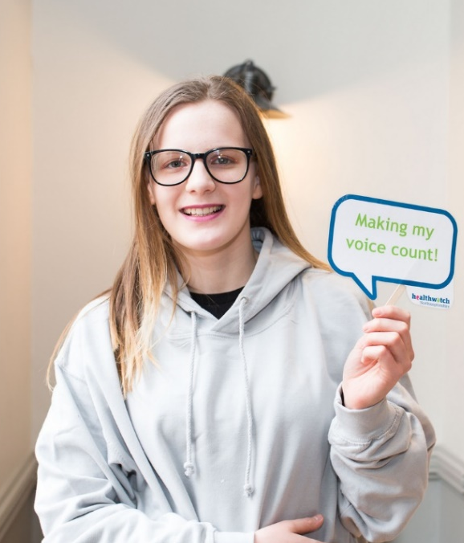
Snapshot of themes
Triaging – A varied understanding of the pressures of primary care and the way in which the triaging system that has been adopted works.
Staff Attitudes - Whilst some people were sympathetic to the workload of practice staff and GPs, others were frustrated at having to explain their issues to patient advisors during the triage process.
This was made worse if the healthcare professional then acts in a way that demonstrates they have no understanding of why the person has a consultation with them.
Positive feedback often centres on the staffs’ ability and capacity to show empathy to the patient when dealing with their enquiry.
Face to Face consultations – Concern that the lack of face to face consultations leads to an inferior service is a theme that resonates through the responses. Worry that telephone consultations are not adequate or that if they needed a face to face consultation, that it wouldn’t be available.
“Phone call consultations don’t make me feel reassured. I cannot see how a doctor can discuss a condition or make an informed decision as to what is wrong. If a patient is not known to a particular doctor in the surgery, they cannot see the weight, skin condition, and other conditions that the patient may be unaware they have. The patient may not be able to explain their condition over the phone.”

Slide 19
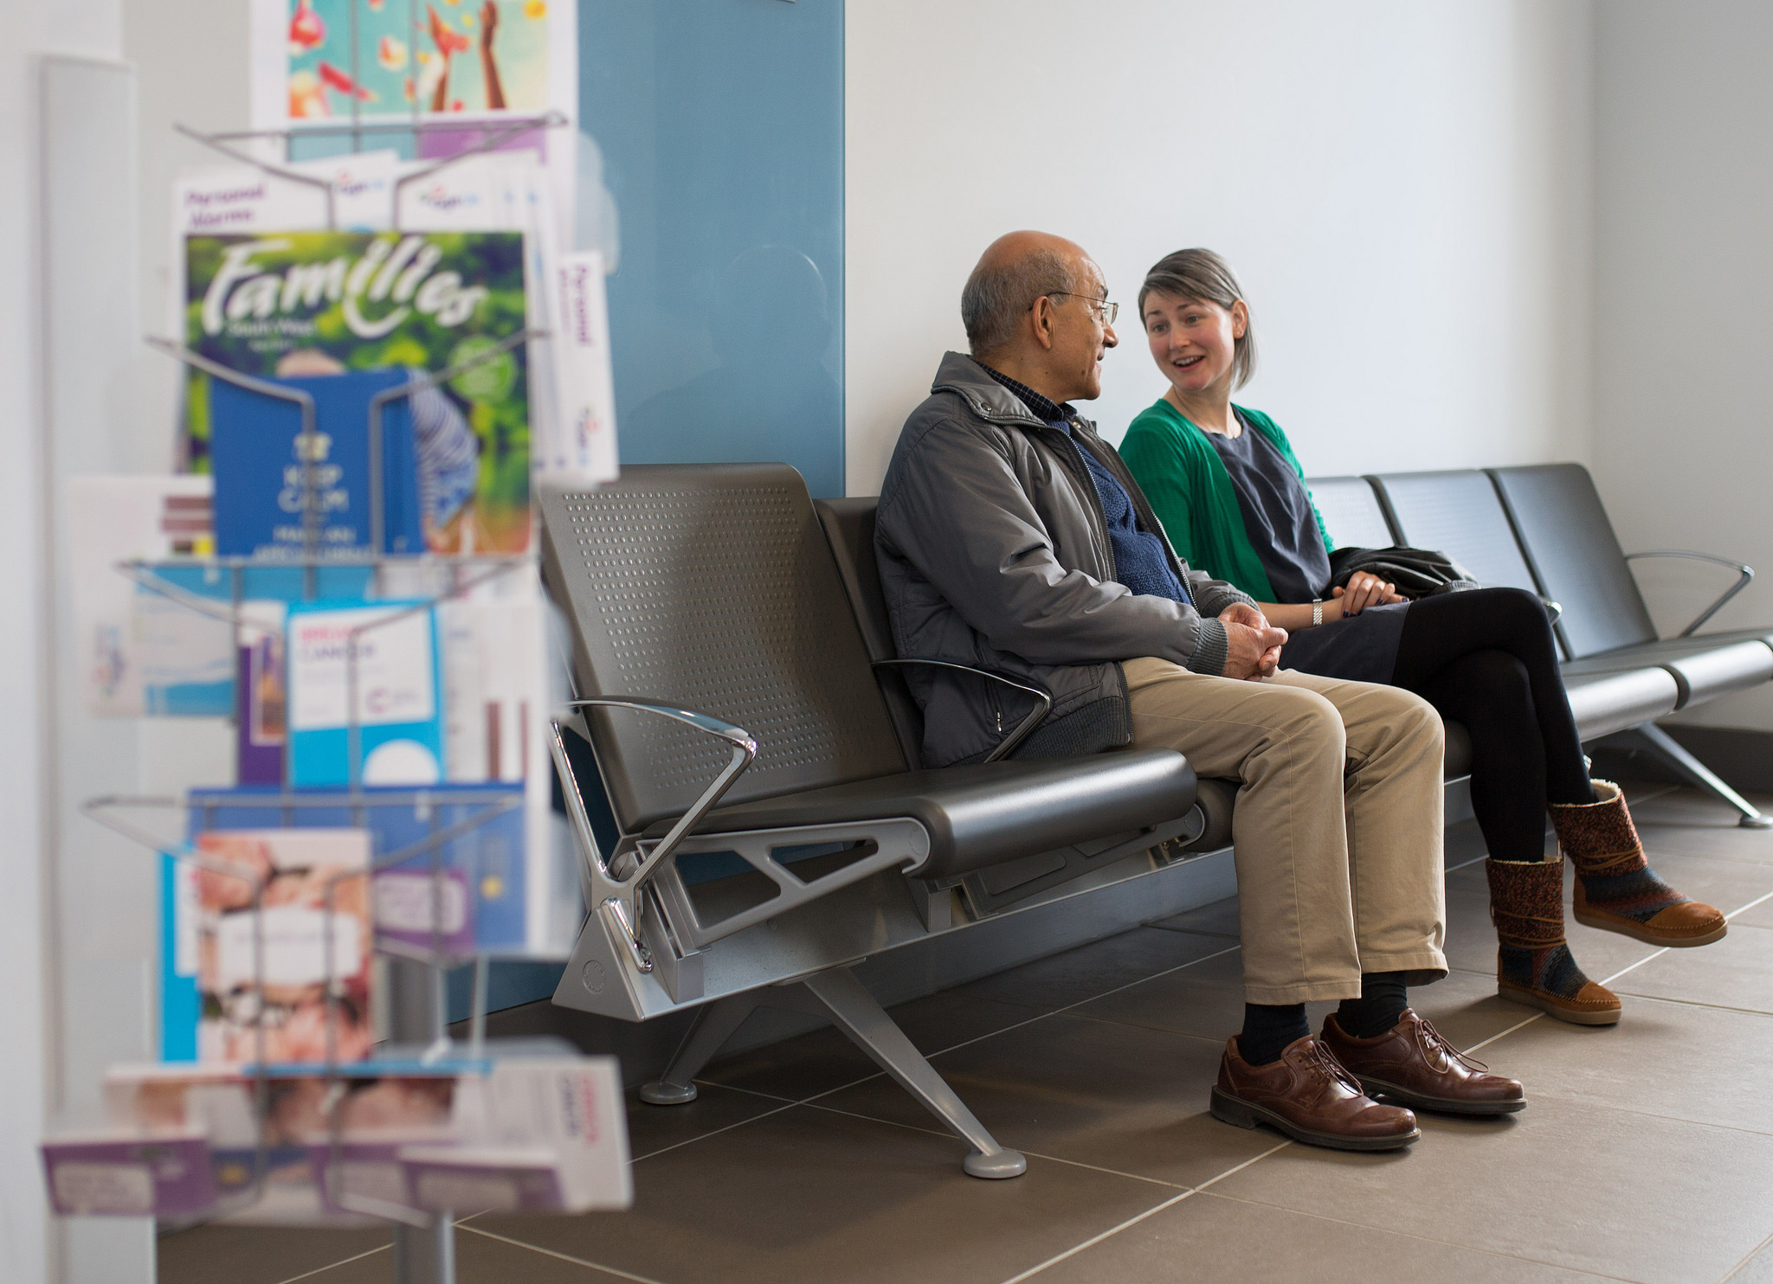
What Sussex patients shared

Slide 20
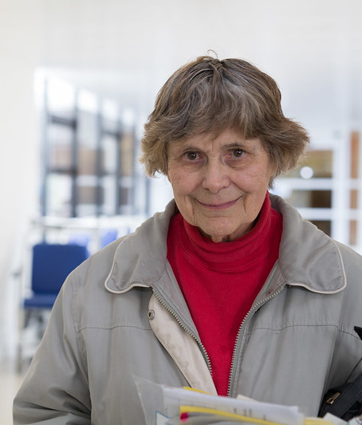
What patients shared
Headline quantitative analysis
The survey had good coverage of the Sussex Practices:
The majority of respondents said they last contacted their surgery between October and December 2021. 40 % of these being in November 2021.
86% state they had contacted their surgery for their own needs (rather than for someone else).
43% of respondents had tried self-care before contacting their surgery. However, this is in the context that 75% of stated need related to follow-ups, medication reviews, non-urgent care.
Only 25% stated they felt they had an urgent reason for contacting.
Resident Location | No. of Surgeries | Range of responses | Ave.
Brighton and Hove | 26 | 1 to 17 | 6
East Sussex | 81 | 1 to 54 | 8
West Sussex | 81 | 1 to 33 | 8
Thank you to the 1557 people across Brighton and Hove, East Sussex and West Sussex, patient survey.
Brighton & Hove, n131
East Sussex, n 689
West Sussex, n 737

Slide 21
Reasons people had contacted their GP practice
Page 3

Slide 22
What people tried before contacting their practice
Page 7b

Slide 23
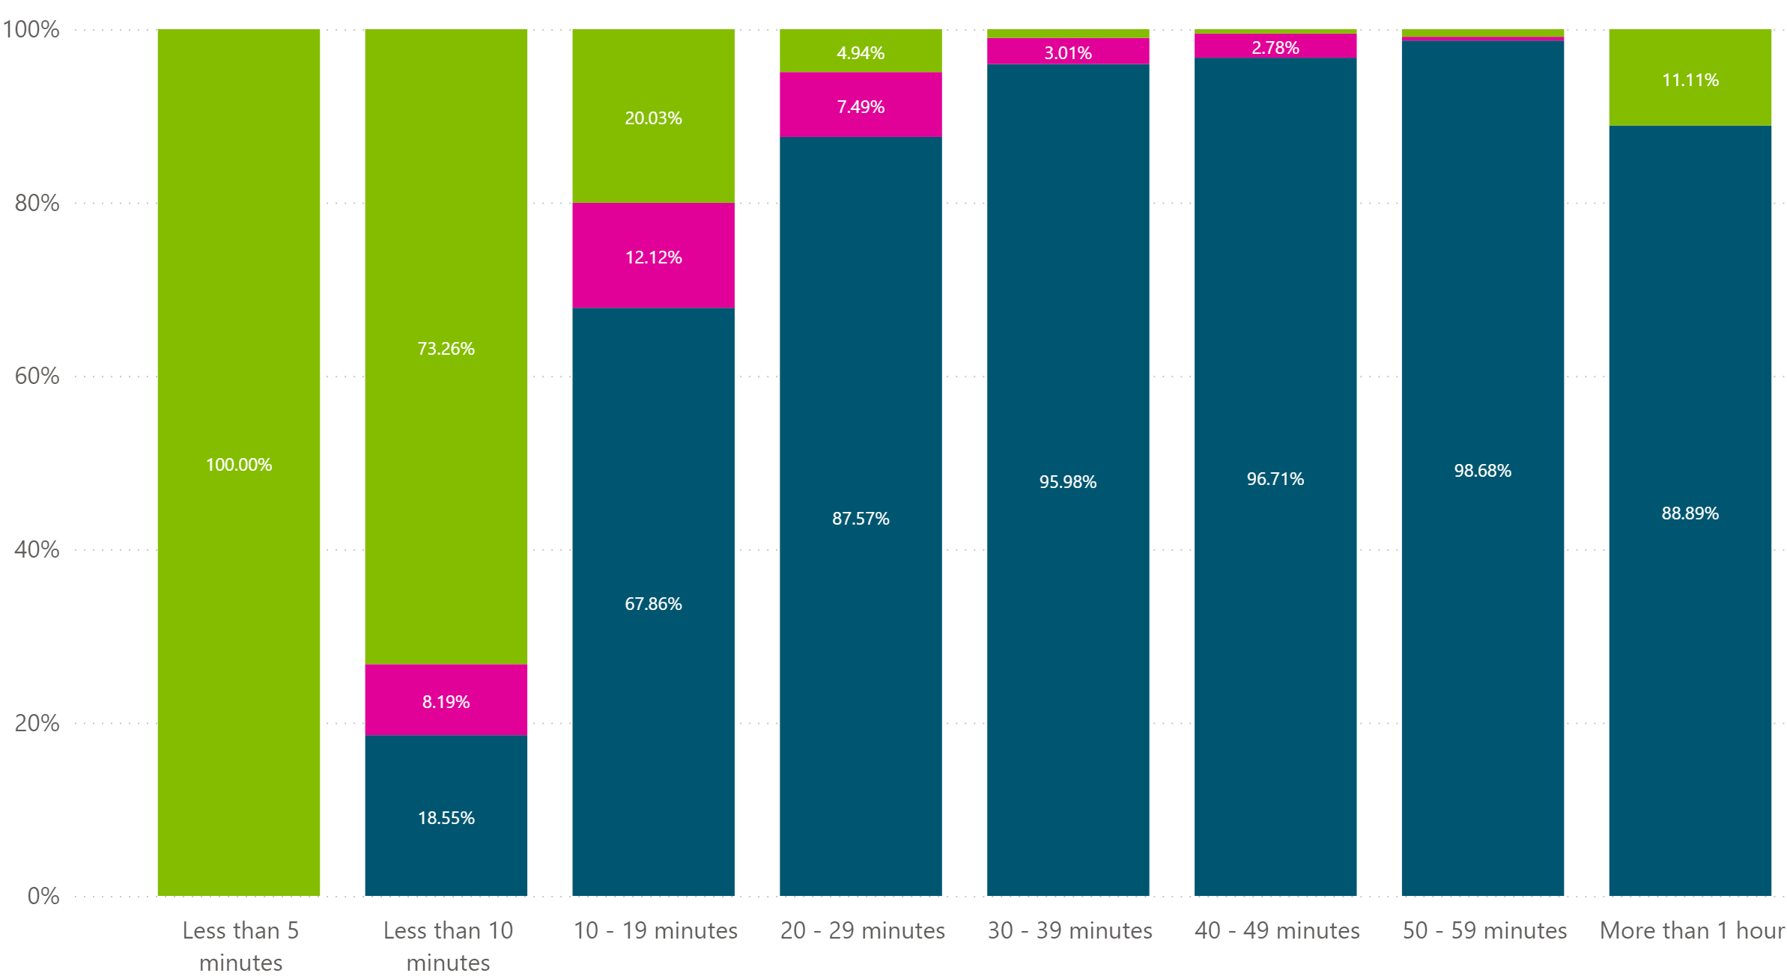
What patients said of access via the phone
Just under half (47.45% said it took less than 10 minutes to get through to a practice on the phone.
Approximately a third (31.78%) had been on the phone for 10 – 29 minutes. Just under 20% had waited between half an hour to an hour, and 9 people stated they had waiting over an hour.
Negative satisfaction greatly increases after a 10 minute wait.
(Across the region, including Sussex.)
Satisfied
Not satisfied
Unsure
Less than Less than 10-19 20-29 30-39 40-49 50-59 More 5 mins 10 mins mins mins mins mins mins an hour

Slide 24
Comments reflecting positively where practices have invested in new phone systems.
People commented positively on being able to get a ‘ring back’ for when their queue position reached the top of the list.
The length of the phone message came up numerous times as an issue, with people stating much of the COVID information, for example is unnecessary.
It is important to note since surveying people, national restrictions have ceased, but it is still necessary for the NHS to ask for mask wearing and social distancing, so staff can continue to be well so they can support patients, and to protect clinically vulnerable patients.
People referenced calling as close to 8am (sometimes missing the queue by calling at 07:59) only to find there were no consultations available once their call was answered.
Since they installed the new phone system telephone waits have been much reduced, although not entirely eliminated.
Appreciate the doctor’s surgery will always be busy, but I use a pay as you go phone, and it can cost anything in excess of £2.50 per call … most times they just ask you to ring back.

Slide 25

There were mixed reactions in the commentary towards the use of message detailing the number of people in the queue, with some people suggesting that a countdown for expected response time would be better.
Comments suggest people are either experiencing excellence responses to telephone access or poor, with little in the middle.
Some people stating they have to redial continuously to get through to speak to a person. With some suggesting difficulties, for example access being ‘switched off’ when there are six people in the queue.
Given the contrast of experiences there appears to be an urgent need to move forward with the investment in phone systems across Sussex to improve access, as demonstrated on page 34.
Patients gave examples of being offered inappropriate access, such as a phone consultation for someone who is deaf, or school-aged children having to wait on a call during school times (when they are not allowed access to their phones.)

Slide 26
What patients said of online consultations
Under half (47%) said they were able to use online consultation systems (such as e-Consult).
Across the six regional areas, comparable responses ranged from 41% - 70% (the latter being Hampshire.)
It should be noted, not all practices in Sussex offer an online consultation method, or it is not visible to patients.
Of the 521 users of an online consultation, 64% rated their experience as being very to fairly good. Leaving about 4 in 10 rating the experiences as rather to very poor.
Some of the negative scoring can be attributed to the length of time people waited to get a response.
People have stated they have reverted back to calling the practice.
Under 20% (out of 1,337 respondents) said online consultations had made access easier (with about 43% stating it had made no difference or they were unsure.)
I find the online form appallingly inadequate … it continually tells me to call 111 due to the severity of my condition, but 111 are unable to help me. And so, I am forced to lie about the severity of my pain so that i can use (it) and gain access to a phone call from my GP.

Slide 27
What doesn’t make sense to people
Lack of available appointments is generating phone traffic.
Comments suggest for some there is an inability to describe their needs over the phone or determine if they are urgent.
When information from a GP cannot be accommodated by the frontline processes.
I rang every morning at 8am for 8 days in a row, and two afternoons at 2pm. Each time, when I got to the top of the queue I was told that the appointments were all taken or I got a message saying all the operators were busy.
When you are poorly its hard to self-diagnose against other conditions to say if it is an urgent matter.
I can’t fault the face-to-face service I received, but trying to communicate with the reception staff my needs was somewhat difficult and I didn’t feel I was listened to.
Previous telephone advice from a GP ..was to ask for a face-to-face same day appointment if problem returned. This was deemed impossible by receptionist, as ‘they don’t do that’. Spoke to the practice manager at a later date and he confirmed [that the] receptionist’s comment was correct and the GP should not have given me the advice he did in the original phone call.

Slide 28
Some ‘access routes’ are hard to understand, for example:
Being triaged by reception/call handler, triaged again and then booked for a consultation.
Filling in an online form and the healthcare professional then asking why the person need them?
Text appointment time given, but the consultation taking place hours later. One surgery stated ‘time doesn’t mean anything, we get to call when we can’.
Having a phone consultation when patient’s concern can only be dealt with in person.
Some practices don’t appear to be helping themselves, e.g. imposing changes in process that seem to waste patient time and NHS resources, for example
Initially had a phone appointment, which is totally pointless, as I needed my ear seen and looked at, which I had said when I booked. I was told I had to have a phone appointment first. Wasting time and causing more stress.
Very frustrating that they are telling me that they no longer prescribe my injections, and I will have to attend the surgery for a nurse to administer them. This is a complete waste of time and resources, as I am a nurse and quite capable of self-administration. I shall purchase a private prescription and save everybody’s time.

Slide 29
Receiving clinical advice from non-clinical staff people say installs a lack of confidence in the service or raises anxiety.
However, the reality for other patients was very different, for example, one patient shared that the receptionist recognised that the symptoms being described could mean a DVT and they took swift action.
This suggest a need for reframing the way information is given to people, with more use of sending information ‘from the clinician’ to the patient (links or downloadable leaflets via apps.)
Some comments demonstrate a lack of confidence that clinicians can diagnose over-the-phone and this may be an area where improved communication to patients and the public may help?
The receptionist told me the result of my cholesterol test and said the GP wanted me to follow a low fat diet and have another test in a year. She then went on to suggest foods I could eat to reduce the fat in my diet. I didn’t think receptionists were supposed to give health advice.
It is frightening to be simply told your important blood test was abnormal. I paid to see a private consultant in order to be able to discuss the results and plan a way forward.

Slide 30
In the comments, people noted that hospital staff were seeing patients face-to-face, so why aren’t GPs?
Current time constraints, in some cases appears to be generating more appointment need.
I was given an examination and told by the nurse that it was rushed due to her lack of time. This meant having to book further appointments, as she had not complete the appointment thoroughly.

Slide 31
Do you think you saw or had a consultation with the practice staff who was best placed to deal with your issue/concern?
Page 11
Unsure (n165)
No (n225)
Yes (n922)

Slide 32
What patients shared about their consultations
Many respondents reported they had been told to expect a call back from a doctor and didn’t get a call.
70% of people said that they felt their consultation had been with the right member of the practice staff to deal with their issues/concern. (17% disagreed, and 13% were unsure).
Similar, 70% felt they were clear on the diagnosis, treatment or next steps, following their consultation.
There were example of people turning to private routes in order to meet their needs.
From previous insight, and through our health complaints advocacy partner interactions, people who turn to private providers can experience continuity of care issues.
We believe Sussex NHS Commissioners need to have clear/publicly available information as to what people can expect from the NHS if they self-fund some of their healthcare.
I received a phone call offering an appointment with a nurse. When I turned up, she looked at the problem area, said she couldn’t do anything, and then took a photo to send to another nurse. Two days later, I have had no return call. I have since seen a private consultant to get a diagnosis and treatment.

Slide 33
Clinical advice contradicted by receptionists/practice staff, for example
What people see, for example is an ‘empty’ waiting rooms, does not help people to understand the demand and pressure on GP-led Services.
Improving communication about how people access services now (including posters in waiting areas) may help patients to understand the changes and to reduce the negative narrative that is more widely heard.
I am furious the doctors refer patients to an app they do not know how to use. It is now two weeks since the doctors were told to prescribe the medication (by the app consultant) and I still have not been able to get it. The administrator says I must take a letter in. I have sent an enlarged letter from my phone as the app copied their letter to (doctor) to me. I said it is the best I can do and will be the same whether she or I print it.
As there are fewer patients in the waiting room during these uncertain times, why does it have to take so long to answer the phone when most of the time they’re are between two to four receptionist available.
Not sure why it took so long as they surgery never seems to have anyone in and yet there are plenty of staff around.

Slide 34
Other points to note from what patients shared
Difficulty in getting access has led to potential safety issues or patients coming off medication without appropriate clinical oversight.
Issues with getting access to GPs has a knock-on for other parts of peoples’ life, such as DVLA checks.
From previous insight, and through this survey, it is clear that a lot of GP time is taken up with administrative functions (school letters, forms non-health funding, etc) that the system should be seeking other ways of meeting needs for ‘evidence’. We’ve shared examples of this with our integrated care colleagues.
I have been trying for just short of a year to have my blood pressure checked in relation to medication. Whichever receptionist I speak too, I’m advised to buy a blood pressure kit so I can do it myself. I have since stopped taking my medication, as I’m really concerned.

Slide 35
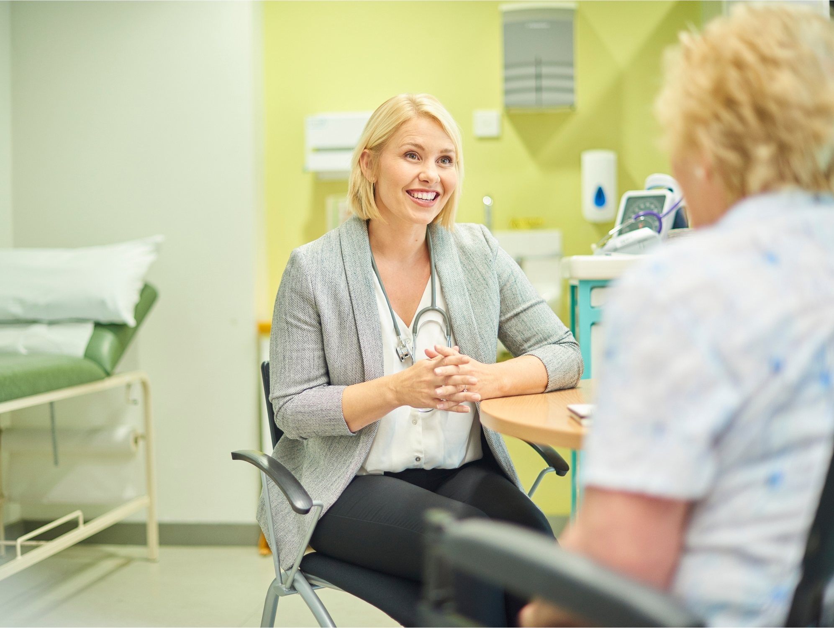
NHS priorities for 2022-2023

Slide 36
NHS England 2022/23 National Priorities
Page 3
On 24th December 2021 NHS England published the 2022/23 priorities and operational planning guidance, which sets out the priorities for the year ahead and was further updated on 23 February 2022. The key priority for primary care is to improve timely access to primary care by maximizing the impact of the investment in primary care and Primary Care Networks, to extend capacity, increasing the number of appointments available and driving integrated working at neighbourhood and place level. This is one of eleven priorities, a number of which have additional implications for General Practice and are included here for their relevance and to demonstrate the breadth of work for primary care services.
Planning Priority – Improve timely access to primary care
Ask of primary care:
Continued integration of services closely with community care.
Extend the primary care workforce to increase capacity, particularly in terms of the number of primary care network (PCN) roles and GPs, through of the Additional Roles Reimbursement Scheme (ARRS) and other support for the workforce.
Continued need to provide good level of access, including digitally.
Implementation of two new Direct Enhanced Services (DES) for planned anticipatory care and personalised care and an expanded focus on cardiovascular disease and prevention. Address the backlog of interventions for patients with long term conditions.
Increased use of community pharmacy services

Slide 37
NHS England 2022/23 National Priorities
Page 3
Planning Priority – Invest in the workforce
Ask of primary care:
Accelerate the introduction of new roles such as anaesthetic associates and first contact practitioners and expanding advanced clinical practitioners.
Develop the workforce required to deliver multidisciplinary care closer to home, including supporting the rollout of virtual wards and discharge to assess models
Planning Priority – More effective response to Covid-19
Ask of primary care:
Delivery of the vaccine programme, planning to maintain the infrastructure that underpins our ability to respond as needed.
Planning Priority – Use of digital technologies to transform patient care
Ask of primary care:
Increase adult registration with the NHS app and NHS UK as part of continued use of digital technology to transform the delivery of care.

Slide 38
NHS England 2022/23 National Priorities
Page 3
Planning Priority – Deliver significantly more elective care to tackle the elective backlog (waiting lists), reduce long waits and improve performance against cancer waiting times.
Ask of primary care:
Though mainly aimed at secondary care providers, we will need to ensure timely presentation and effective primary acre pathways including:
Working with Primary Care Networks to support implementation of early cancer diagnosis as set out in the Network Contract Directed Enhanced Services (DES)
Running local campaigns to complement national advertising to raise public awareness of cancer symptoms and encourage timely presentation
Planning Priority – Improve the responsiveness of urgent and emergency care and build community care capacity
Ask of primary care:
Prevent inappropriate attendance at Emergency Departments
Reduce length of hospital stay
Deliver more capacity at home and improve hospital discharge
Virtual wards to be expanded to managing patients with Covid-19, acute respiratory infections, urinary tract infections, chronic obstructive pulmonary disease and complex presentations such as those living with frailty.

Slide 39
NHS England 2022/23 National Priorities
Page 3
Planning Priority – Improve Mental Health Services
Ask of primary care:
Improve and expand mental health services and meeting the needs of those with autism and/or learning disabilities.
Primary Care Networks to continue with the use of mental health care practitioner ARRS role
Emphasis on the needs of those with autism and/or learning disabilities, with request for practices to ensure they are able to access primary care, the importance of annual health checks and maintenance of learning disability registers.
Planning Priority – Develop an approach to population health management
Ask of primary care:
Utilise improved access to, and quality of data to allow understanding of disease patterns and outcomes to inform patient pathways and patient need.
Particular emphasis on using data to inform prevention initiatives as they relate to the NHS Long Term Plan
Requirement for systems to work to promote prevention, restore the monitoring and management of long term diseases, progress against the NHS Long Term Plan and reduce use of antibiotics.

Slide 40

Improving access in Sussex, shared by commissioners

Slide 41
Page 3
Access to primary care in Sussex
Improving access to General Practice is a key priority for NHS Sussex and a significant amount of work is taking place to bring real differences to patients. This involves working with practices to support them to address some of the immediate and long-term challenges they face, investing in immediate actions, planning for long-term improvements and engaging with patients to understand their views and experience.
Plans for improvements will be going to the NHS Sussex Board in September 2022, which is held in public.
General GP access Data in Sussex
Primary care services in Sussex are operating at higher level than before the pandemic.
Primary care in Sussex saw an increase in demand for appointments in 2021-22 compared to 2019-20.
Practices in Sussex carried out 18,500 more appointments in the last year (2021-22) than in 2019-20 (COVID-19) year.
In June 2022 there were 774,000 appointments in Sussex. More than half of these were face to face (59%).

Slide 42
Page 3
Access to primary care in Sussex – progress made
Workforce
Additional roles are being introduced to primary care networks that work across multiple practices. This includes specialist nurses, mental health practitioners, paramedics, pharmacists and social prescribers – also known as ARRS roles.
GP practices are being supported to share information about the range of roles, when appointments are being made. As practices increase their skill mix and recruit additional roles, appointments will not always be with a GP but with the most appropriate medical professional, based on the clinical need of the patient.
In Brighton, ARRS roles have increased 135% in the past year to nearly 84 full time positions.
In East Sussex, ARRS roles have increased 85% in the past year to nearly 166 full time positions.
In West Sussex, ARRS roles have increased 96% in the past year to nearly 248 full time positions.
Supporting practices to access Employee Assistance Programmes to better support staff and ensure wellbeing of people working in primary care.

Slide 43
Page 3
Access to primary care in Sussex - what we are doing
Digital
Implementing digital solutions as an alternative to face-to-face appointments to make sure patients can access care in a range of ways - phone consultations and online where appropriate.
Introducing cloud-based telephony across Sussex to support practices working together as Primary Care Networks (PCNs) and increase the availability of staff. This will mean that phones could be answered from other locations and allows more calls to come in at any time.
Introducing e-Hubs - virtual online consultation hubs managed centrally by a group of care navigators and clinicians. Centralising the management and triaging of online consultations allows practices to spread demand, share workforce and skill mix and improve joined up working between different practices.
Digital Ambassadors are being piloted across Sussex who will provide support to patients to learn how to use digital health care tools, like the NHS App, online consultation and remote monitoring health tools – like blood pressure monitors. Over the past year, NHS Sussex has seen an increase in use but there is more to be done, especially with diverse communities, those who are digital excluded, and people who find it less easy to get online.
Working with GP practices to improve websites and make it more consistent. NHS Sussex has developed one good practice website together with Healthwatch and patient input, this work recognises issues around some websites being outdated and confusing to navigate.
We have set up a “roving” GP service to support patients who are housebound and to carry out home visits.
Community pharmacies already play a significant role in supporting general practice through giving advice to patients and treating minor illness symptoms. We are also implementing a Community Pharmacist Consultation Service across Sussex.
28 PCNs are live with a further 8 in progress. 4,014 referrals were made by the service this year and a plan to have all PCNs using the pathway by September.

Slide 44
Page 3
Access to primary care in Sussex – Future plans
Enhanced access
In October, an Enhanced Access model is being rolled-out across Primary care to enable patients to access a wide range of services outside of traditional core hours.
By March 2023, we will make use of the GP Patient Survey results for practices in the PCNs :
identify patient groups experiencing inequalities in their experience of access to general practice
develop, publish and implement a plan to improve patient experience and access for these patient groups, taking into account demographic information including levels of deprivation.
Community pharmacies already play a significant role in supporting general practice through giving advice to patients and treating minor illness symptoms. We are implementing a Community Pharmacist Consultation Service across Sussex, so far:
28 PCNs are already live, with a further 8 in progress.
4,014 referrals were made this year and plan is to have all PCNs using the pathway by September 2022.

Slide 45
Access to primary care in Sussex – Future plans
The new vision for integrating primary care
The new vision for integrating primary care is, improving the access, experience and outcomes for our communities, centres around three essential offers, which are:
Streamlining access to care and advice for people who get ill but only use health services infrequently, providing them with much more choice about how they access care and ensuring care is always available in their community when they need it
Providing more proactive, personalised care with support from a multidisciplinary team of professionals to people with more complex needs, including, but not limited to, those with multiple long-term conditions
Helping people to stay well for longer as part of a more ambitious and joined-up approach to prevention
Enable primary care in every neighbourhood to create single urgent care teams and to offer their patients the care appropriate to them when they pop into their practice, contact the team, or book an online appointment. The importance of improvement support, data and leadership is central to making this work
Take currently separate services and organise them as a single integrated urgent care pathway in the community that is reliable, streamlined and easier for patients to navigate.

Slide 46
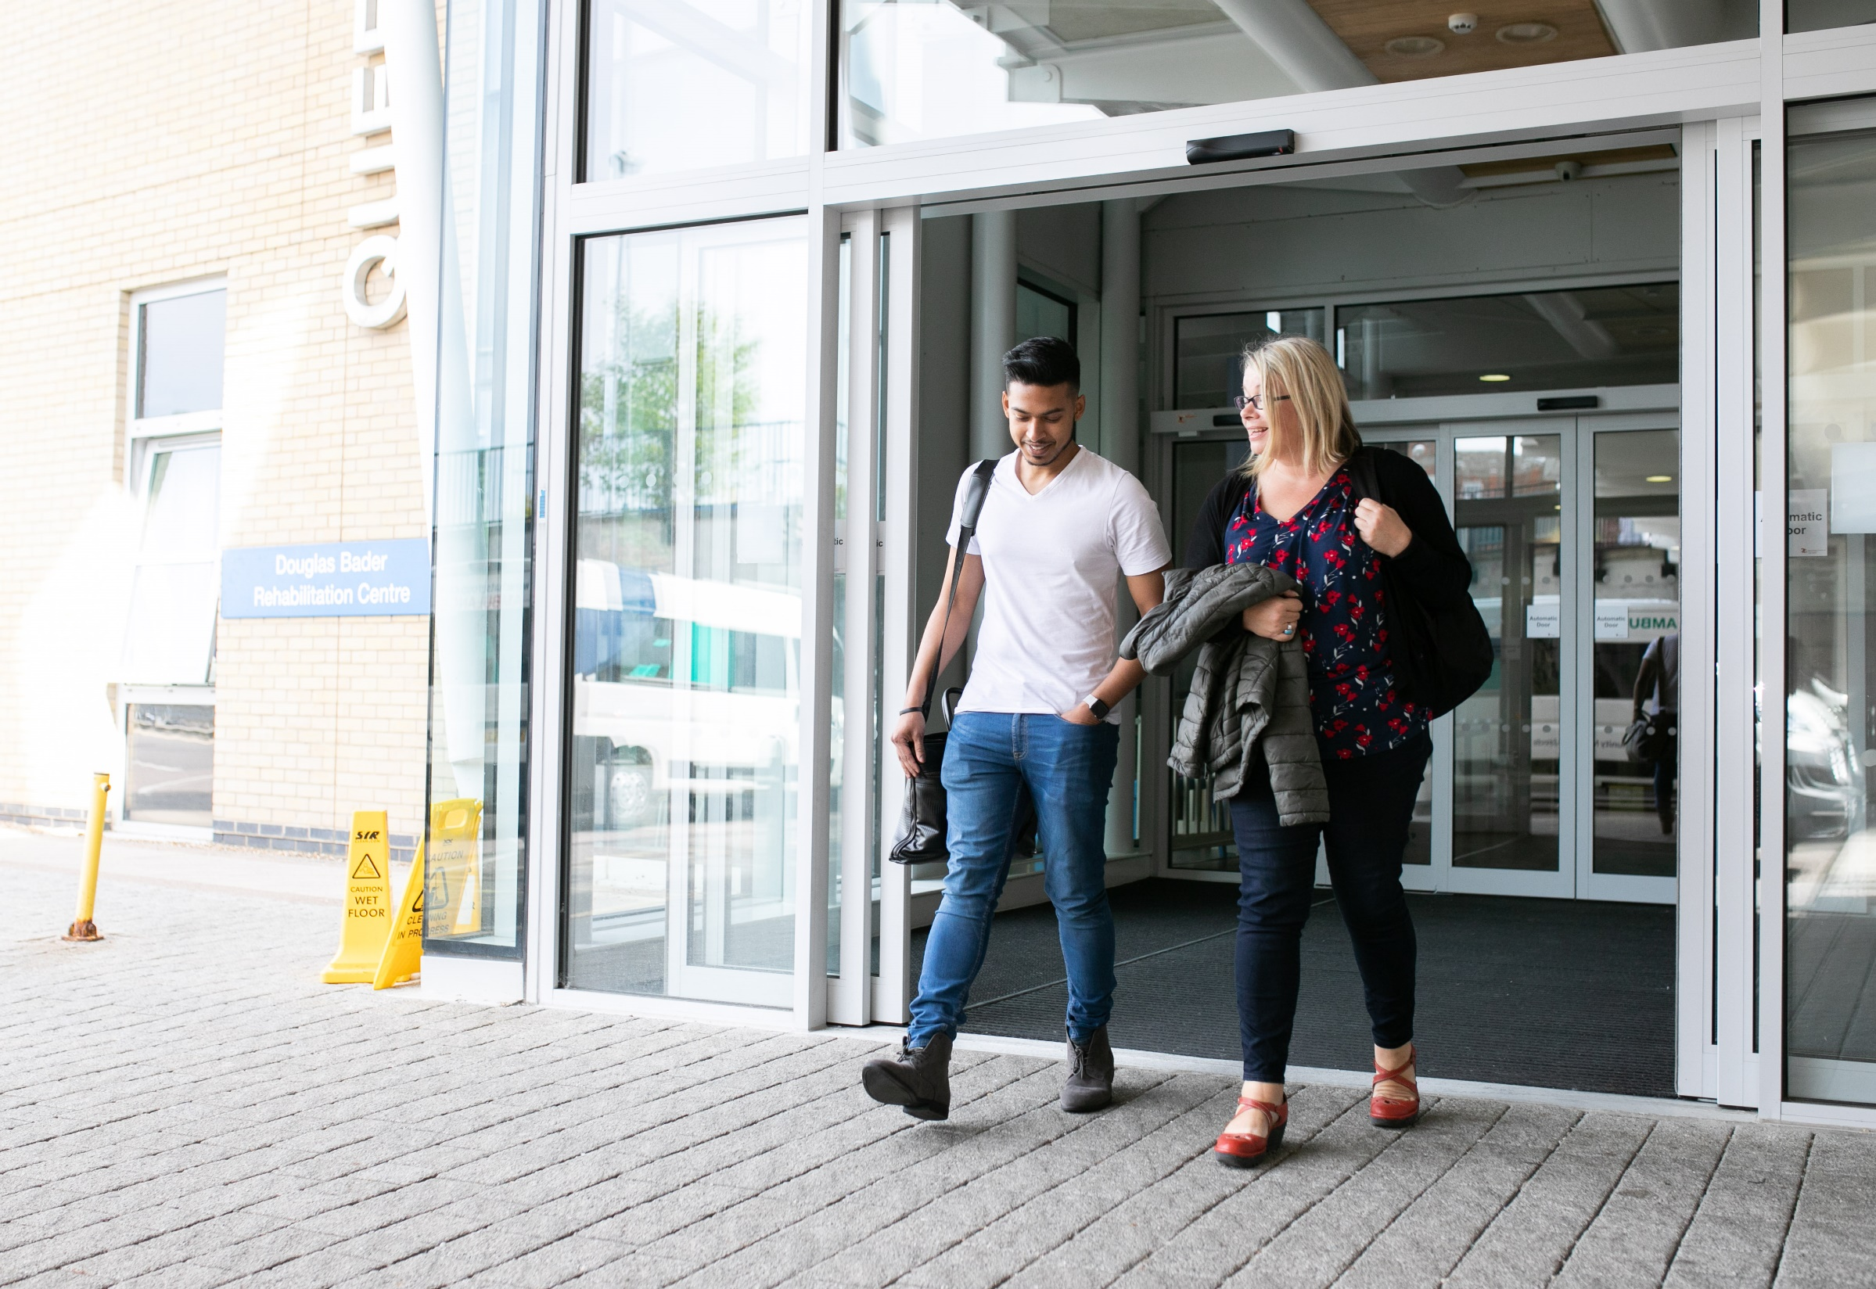
Recommendations and next steps
Notes:
Should this not also include recommendations from the staff recommendations?

Slide 47

Patient Recommendations for GP Services (made in May 2022)

Slide 48
Patient recommendations
.
Phone systems
New phone systems or increased number of call handlers or lines dedicated to appointments booking should be put in place to unblock lines for enquiries and test results and reduce call waiting.
Phones able to have a third person in the consultation.
Dedicated phoneline for registered carers.
Review pre-recorded messages to ensure they don’t deter patients or lead them to believe they are a burden on an overstretched service
Implement phone queue system in all services as it removed the stress of constantly trying to get through, even if it takes a long time
Each surgery should look at ways in which to increase the efficiency of call handling
in order to prevent long telephone queues.

Slide 49
Patient recommendations – continued
.
Appointments and consultations
More specific time slots (i.e. 1 or 2 hour windows instead of ‘morning’ or ‘afternoon’) for phone consultation/GP calls to help people plan their day to take the call.
Increase the opportunities for face to face meetings giving people the choice of virtual or in person appointments/consultations.
Alternative methods to cancel an appointment.
Information technology
Review online application forms as they are reported to be repetitive, confusing, poorly constructed with limited choices, and to improve response time.
Improve relevance of e-consult questions by providing the option of free text.

Slide 50
Patient recommendations – continued
.
Communications
Inform patients as far as possible of changes to practice staff.
Patient engagement regarding the role of clinicians and patient advisors in the surgery, with emphasis on the importance of triaging.
Clear communication regarding the future of primary care consultations.
Include information on websites about the different staff in the surgery.
Calibrate patient need (e.g. to see a clinician) sensitively, taking care not to suggest their concern/issue is more or less serious.
All staff GP practice staff conducting a consultation, should introduce themselves and their role within the practice.
Training for staff on autism and learning disabilities so they can better understand their needs.

Slide 51

Next Steps
We plan to follow up this by
Taking similar reports being produced in the South-East Region from the Local Healthwatch participating areas, we will produce a regional project report, including all of the rich learning from this collaboration.
We aim to publish in May 2022.
Resources allowing, we’ll use the insight from staff and patients to support practices with a communication toolkit that has been collaboratively designed.
We will NHS Sussex what they have learnt from people through this work and how this will be used going forward and compare the recommendations against the plan agreed by the Board in September 2022.
We will take opportunities to showcase this work nationally and continue to seek examples of good practice that we can share back to our Integrated Care System and local practices.

Slide 52
Acknowledgements
This collaborative work was made possible with the help, support and guidance of the project advisory group members:
Local Healthwatch Managers in Wiltshire, Isle of Wight, West Sussex, Bracknell Forest, Royal Borough of Windsor and Maidenhead, Slough.
Healthwatch West Sussex – Volunteer and Locum Practice Manager
Care Quality Commission – Primary Care Lead
NHS Sussex - Commissioner
Wessex Local Medical Committee Doctors
Isle of Wight Council - Scrutiny Officer
Frimley Clinical Commissioning Group – Slough Associate Director of Primary and Community Care Transformation
GP Practice Managers from Sussex
Hampshire and the Isle of Wight Clinical Commissioning Group - Primary Care and Communication staff.
Please note that we also involved a wider range of people in testing and feeding back on surveys.

Slide 53
For more information
Healthwatch West Sussex PO Box 1360 Crawley West Sussex RH10 0QS
www.healthwatchwestsussex.co.uk
t: 0300 012 0122
e: helpdesk@healthwatchwestsussex.co.uk
@HealthwatchWS
Facebook.com/HealthwatchWestSussex

